Slide 1




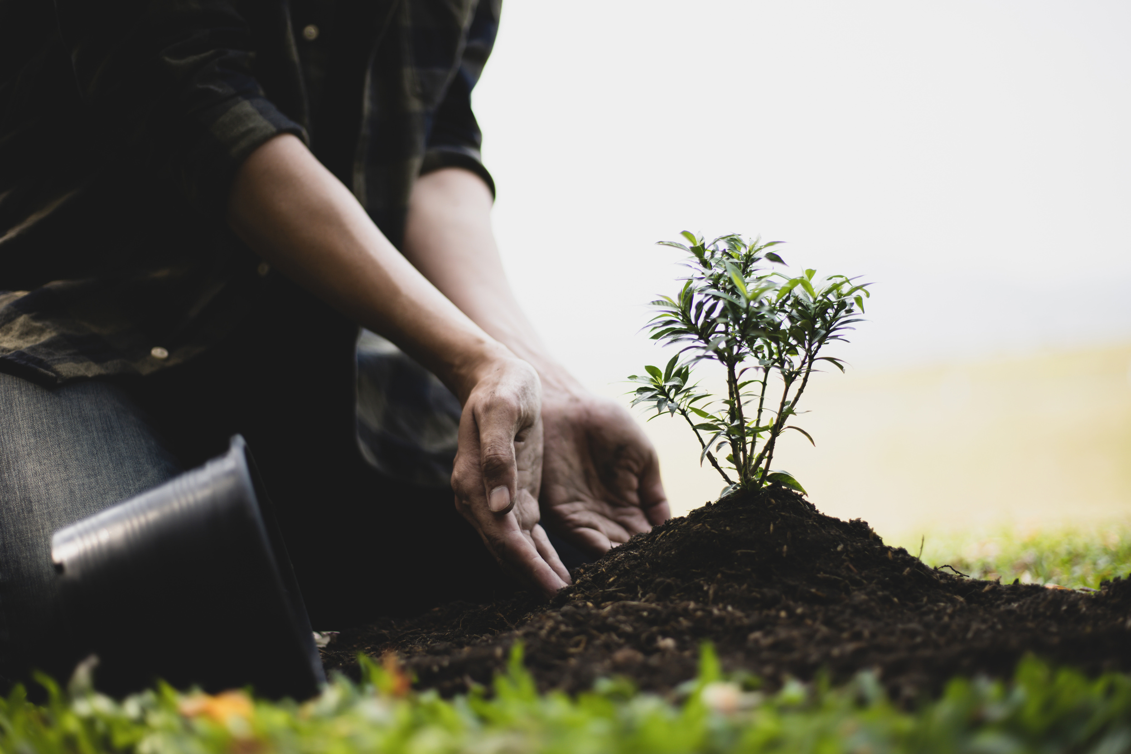

www.reallygreatsite.com
IOT-POWERED
AUTOMATIC WATERING SYSTEM FOR PLANTS
Revolutionizing Plant Care

Slide 2
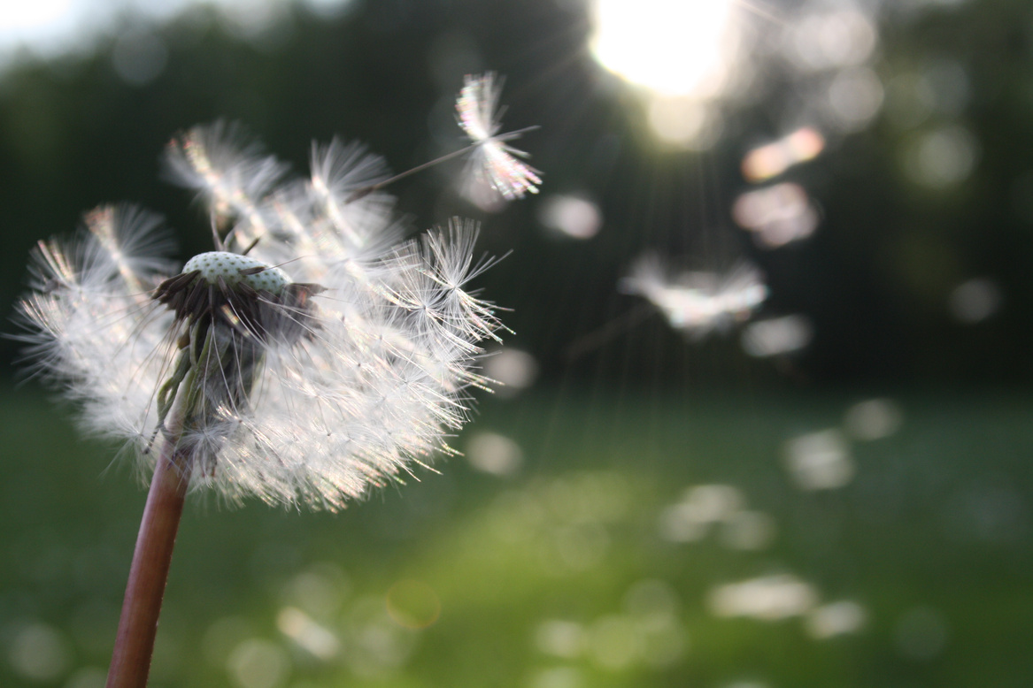

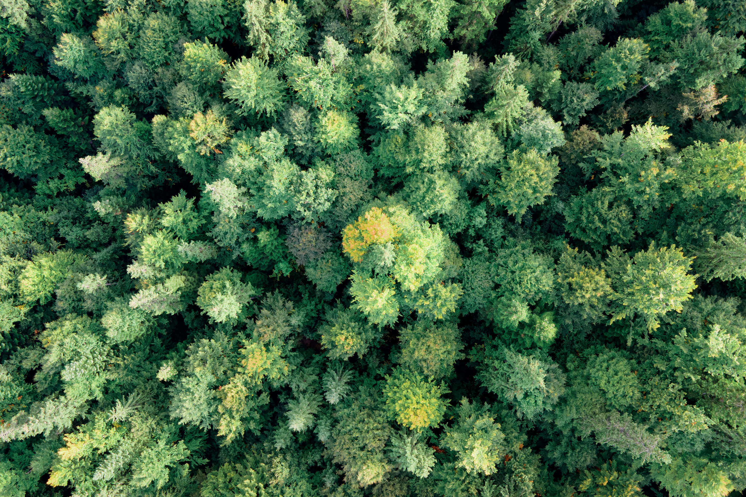


Introduction
The Importance of Proper Watering
Water is essential for plant survival and growth.
Incorrect watering can lead to plant stress or death.
Challenges Faced by Plant Owners
Busy schedules and frequent travel.
Managing different watering needs for various plant species.
NEXT PAGE

Slide 3
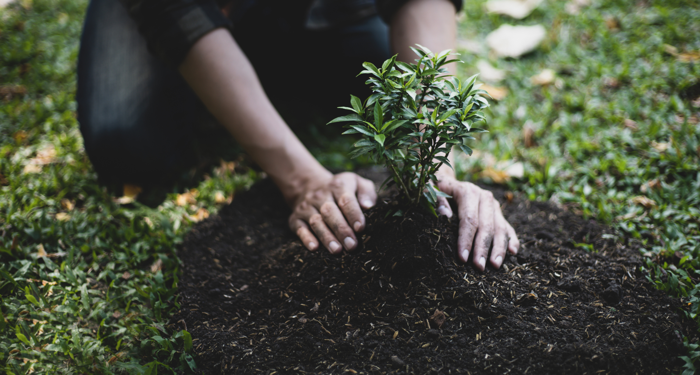
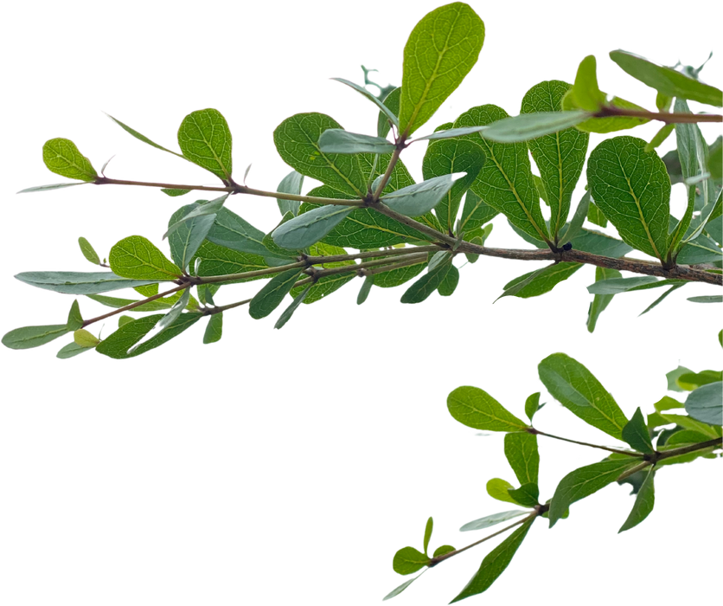

Problem
Inconsistent Watering
Irregular watering causes drought stress or waterlogging.
Forgetfulness
Modern life distractions lead to neglected watering routines.
Overwatering Risks
Excessive watering can harm plants due to root rot and fungal diseases.

Slide 4
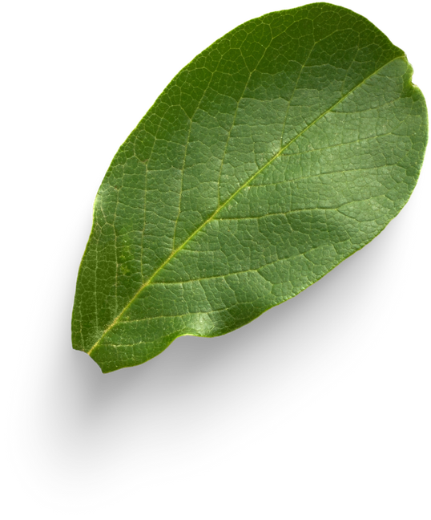

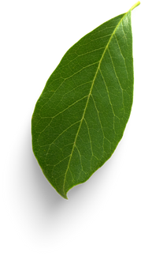
Why an Automatic Watering System?
Simplifies Plant Care
Automates the watering process, reducing manual effort.
Optimizes Water Usage
Delivers the right amount of water when needed.
Enhances Plant Health
Prevents overwatering and underwatering.

Slide 5





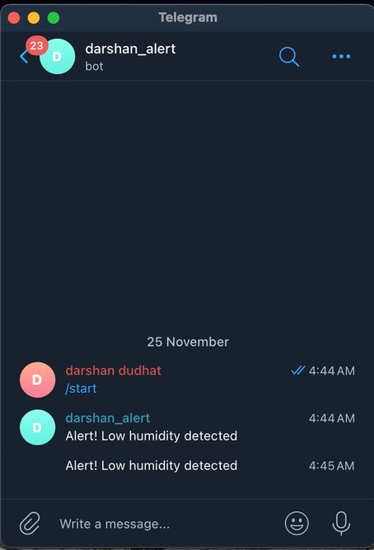
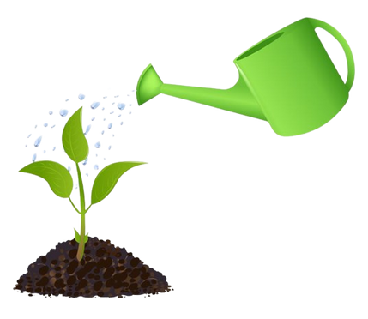
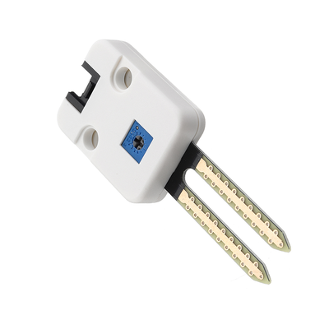
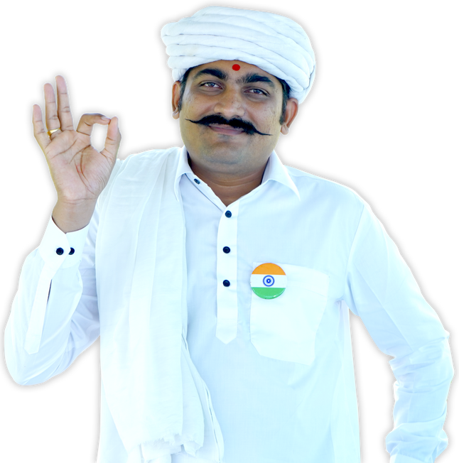

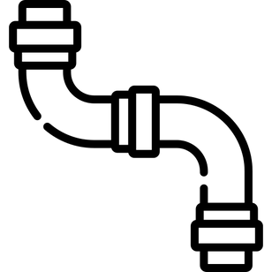
Architecture Overview
through python script
publishing data
Sending Notification to user
storing data
M5Stack
Earth sensor
Water Supply

Slide 6
Target Audience
Household Plant Owners
Ideal for busy individuals or frequent travelers.
Office and Indoor Plant Care Providers
Maintains plant aesthetics with minimal oversight.
Small-Scale Farmers and Urban Gardeners
Enhances productivity in limited spaces.

Slide 7
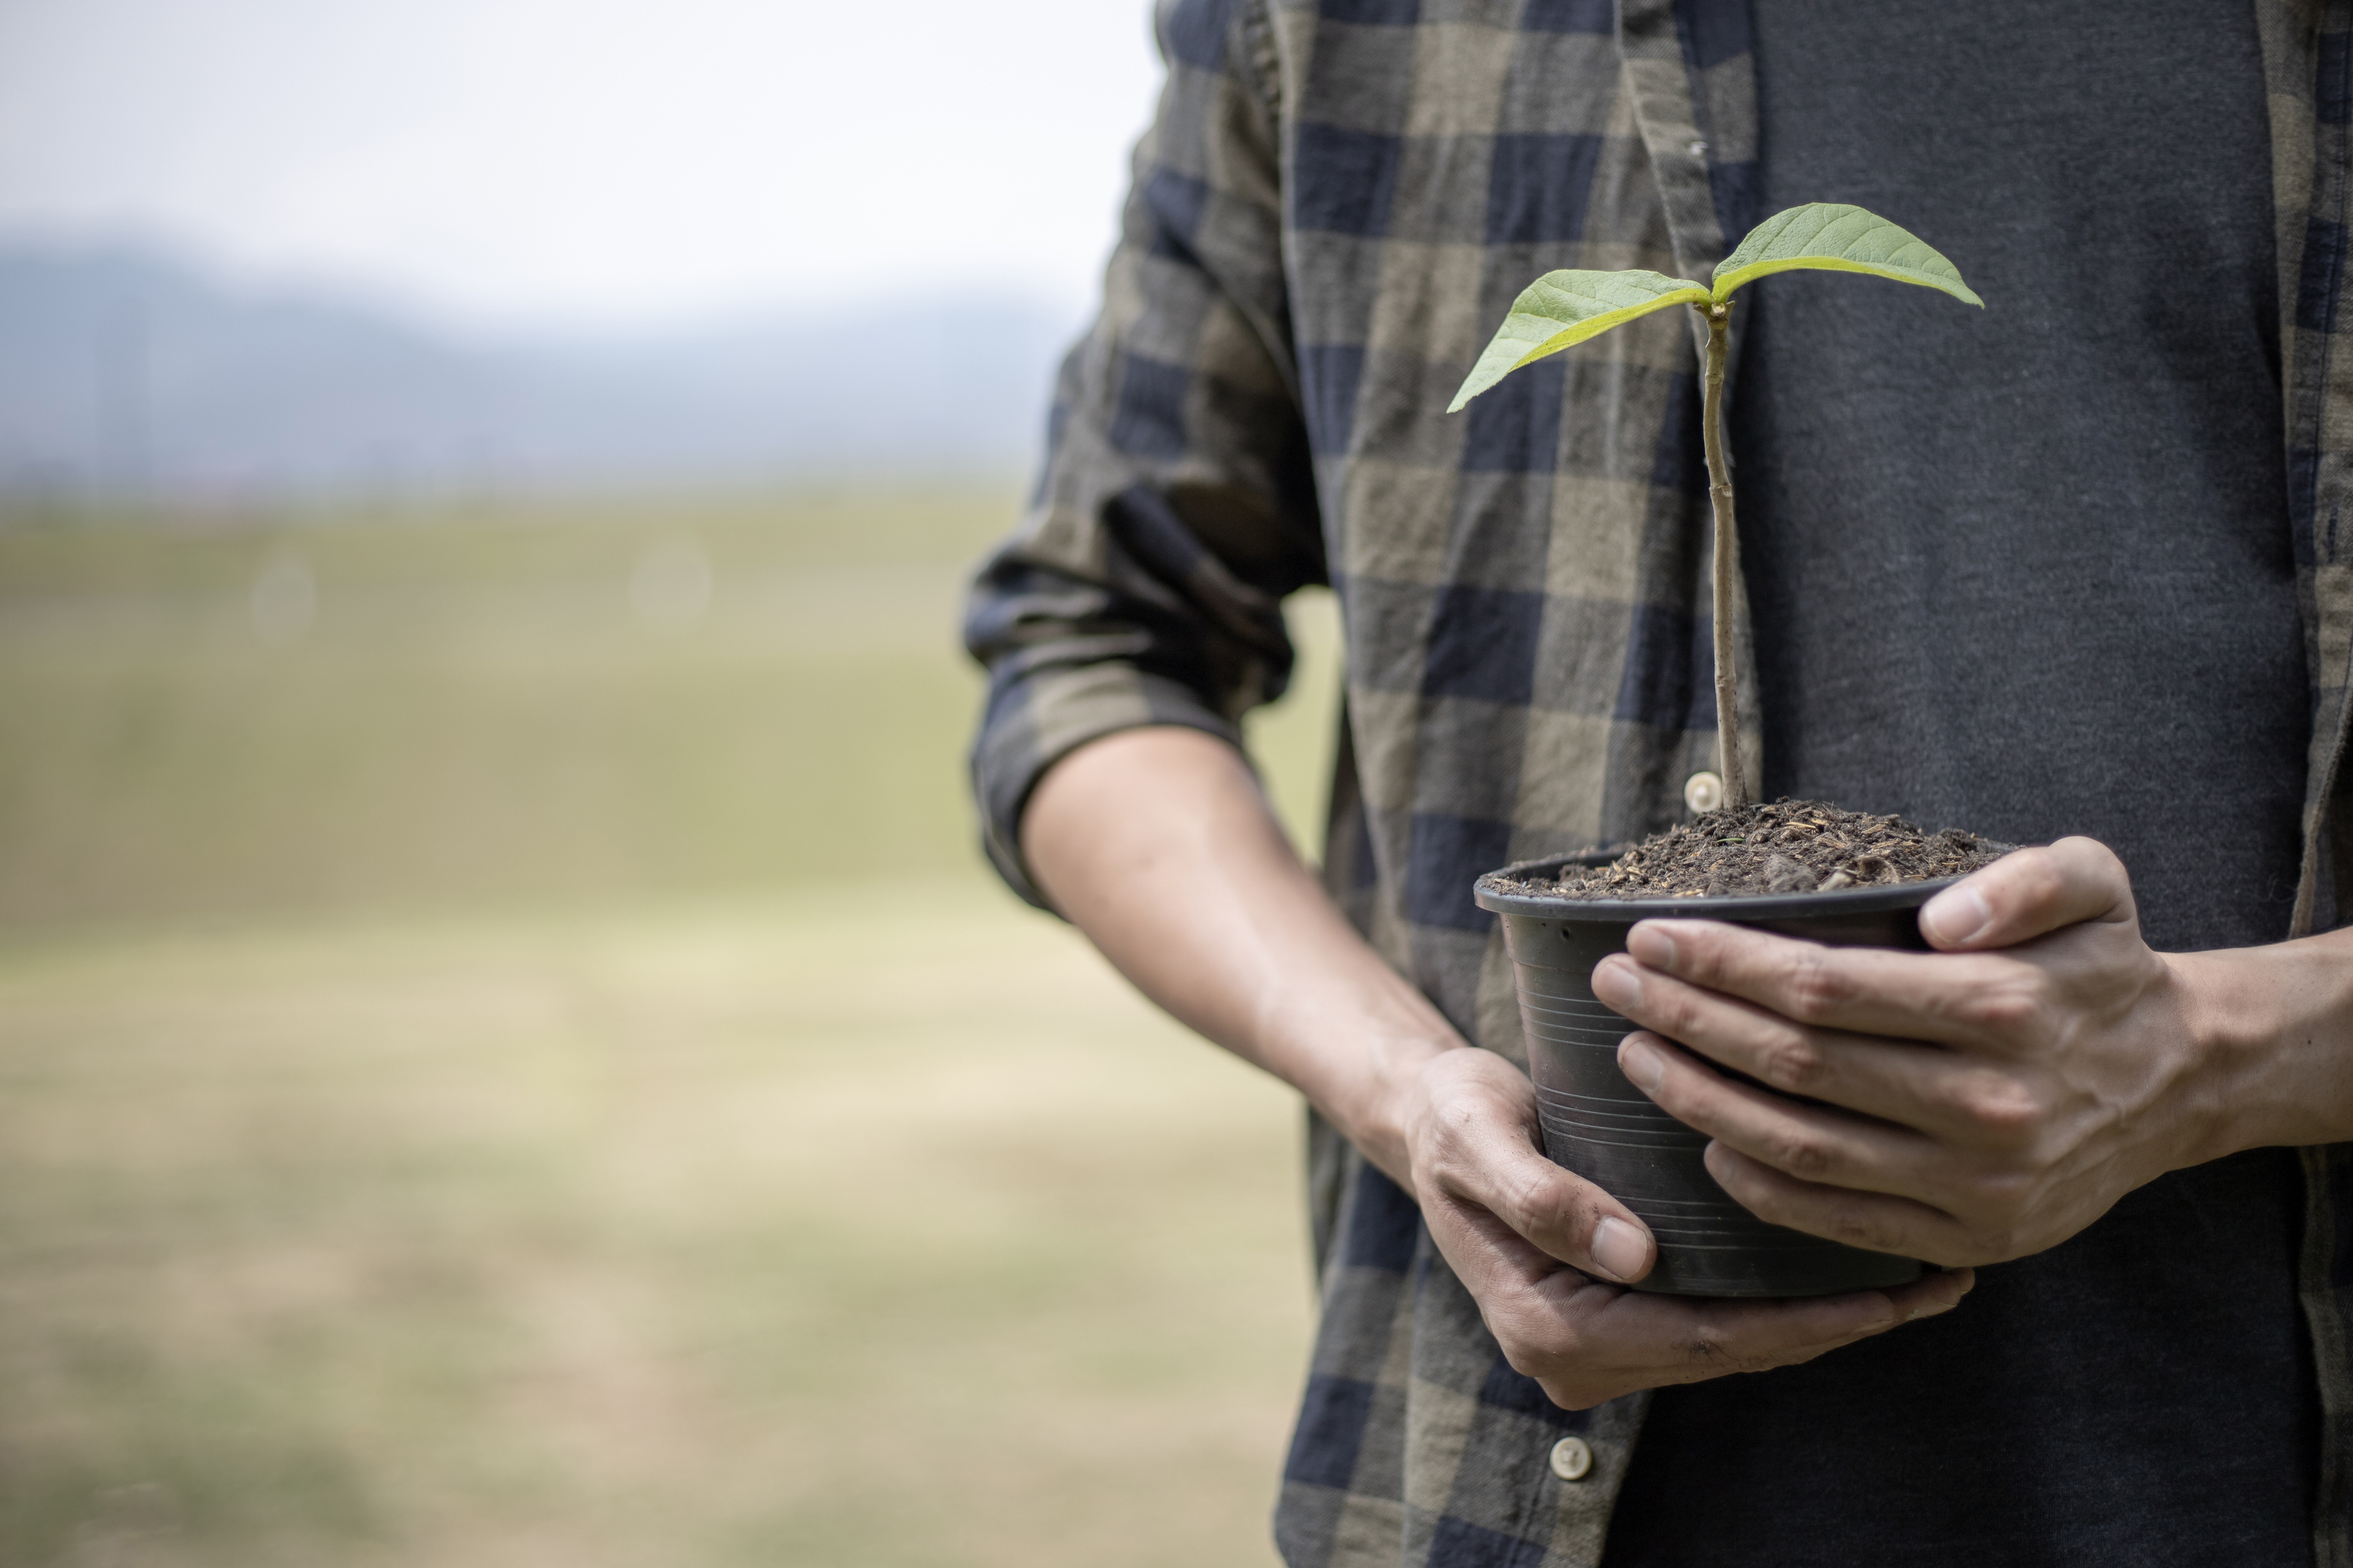
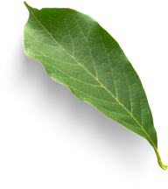
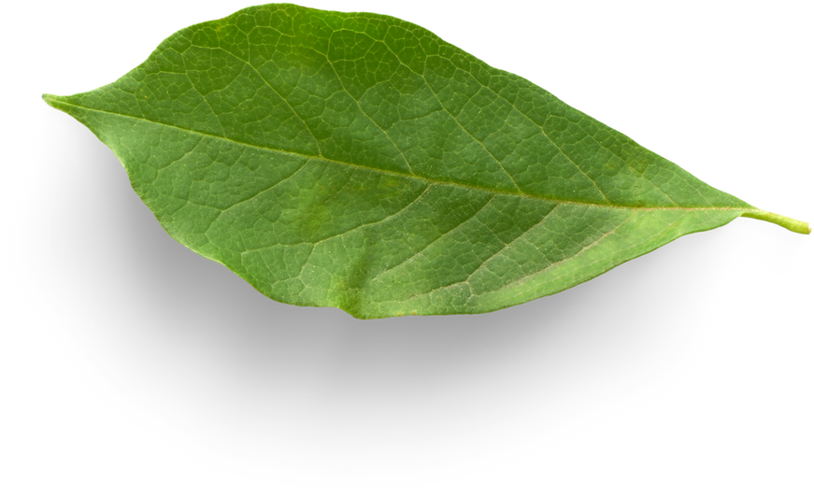

Advantages of the System
Ease of Setup
Dependability
Adaptability
Efficiency

Slide 8
LET’S SEE DEMO

Slide 9
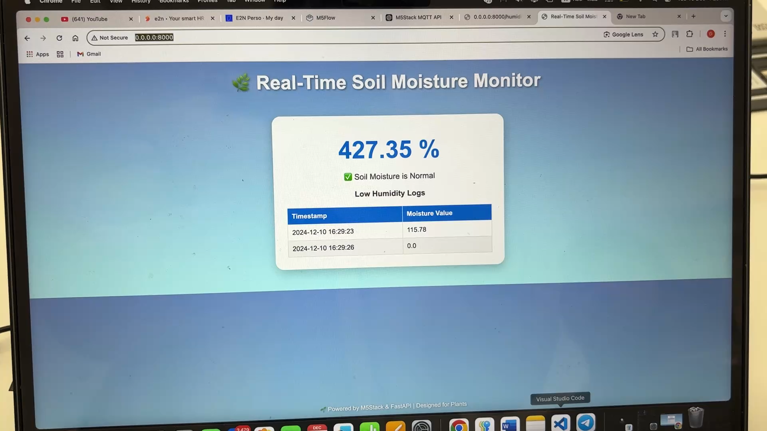

Slide 10
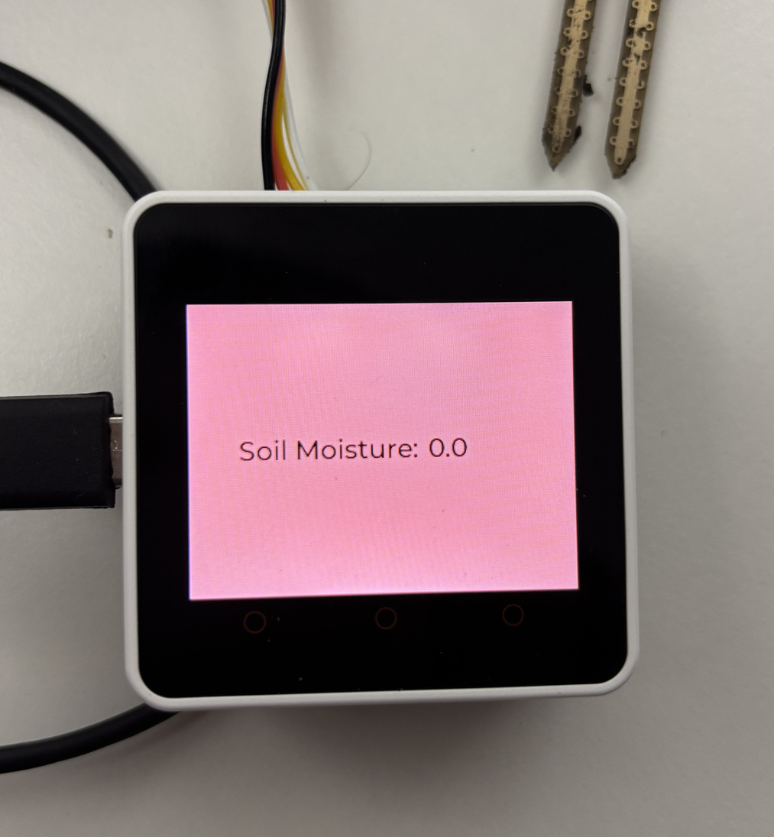
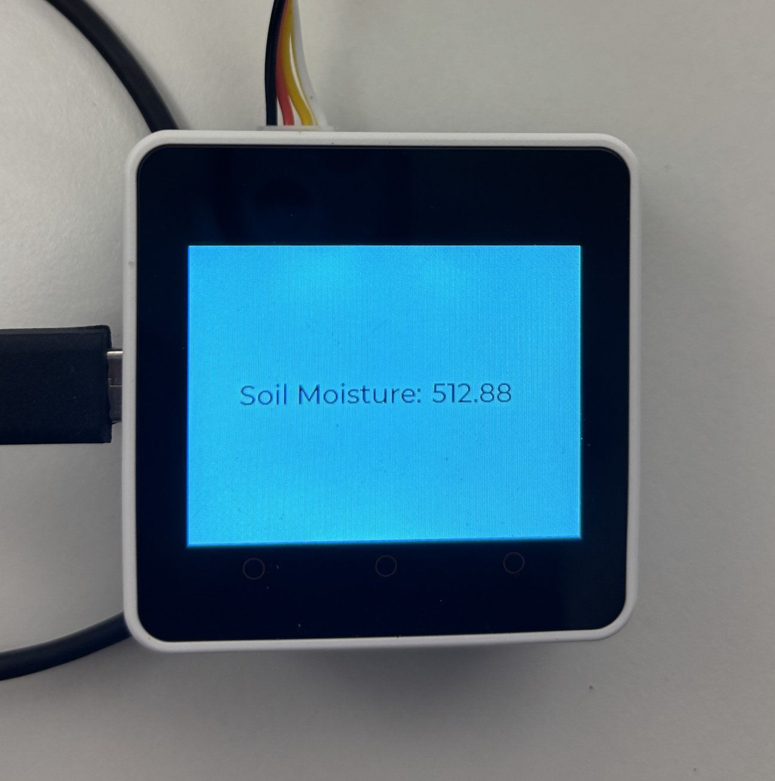
if moisture level is < 300
if moisture level is > 300

Slide 11
Business Model
Revenue Streams
Hardware Sales: IoT sensors, automated irrigation systems, communication modules.
Subscription Services: Cloud-based analytics and AI insights ($10–$100/month).
Consulting Services: Tailored solutions for large-scale farms and enterprises.
Business and Market Potential
Growing Demand
Urbanization Trends
Cost Savings
Environmental Impact
Competitive Edge

Slide 12
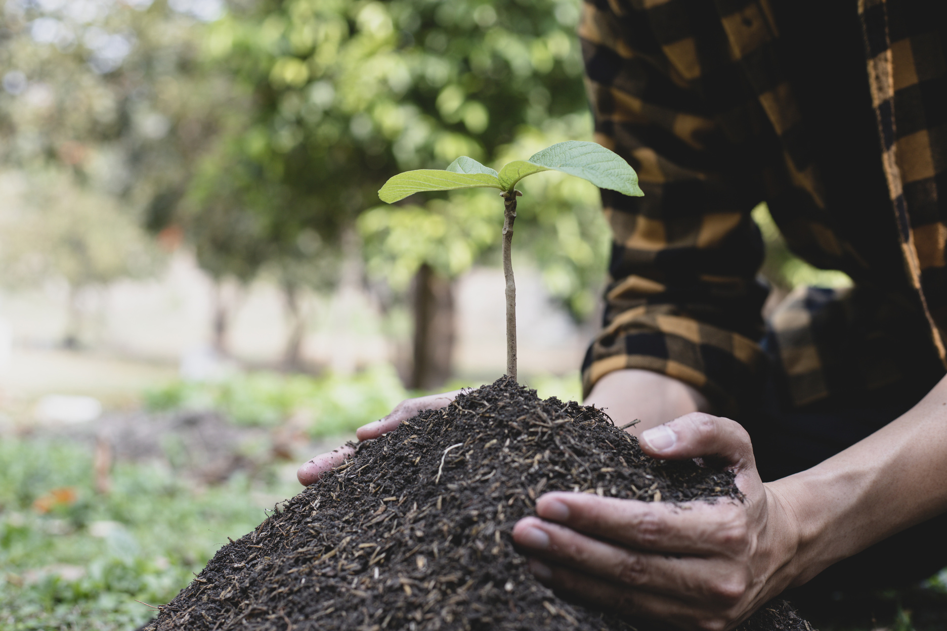

Future Enhancements
Expansion into Agriculture
Adapt the automatic watering system for use in agricultural settings.
Scale up the technology to support larger fields and diverse crops.
Precision Irrigation Techniques
Implement advanced sensors for soil moisture, nutrient levels, and crop health.
Utilize data analytics to optimize watering schedules for maximum yield.
Integration with Farm Management Systems
Connect with existing agricultural software for seamless operation.
Enable centralized control over multiple irrigation systems.

Slide 13

THANK YOU!

